Slide 1
Lecture 6 How does compilation and interpretation really work?
EECS-214

Slide 2
Quiz 1
Monday, April 25
In class, closed book
Will cover material up through binary search trees
Will not cover C#
You will be given a practice quiz next week
And solutions later in the week

Slide 3
Why study programming languages?
You may want to implement a scripting language or macro language for an application you’re working on
Word, Excel, Web browsers, etc.
You may be working on a problem for which typical programming paradigms are inappropriate
Make a new paradigm!
Design your own language
Make a simple interpreter for it
You’ll be making a scripting language interpreter for assignment 2

Slide 4
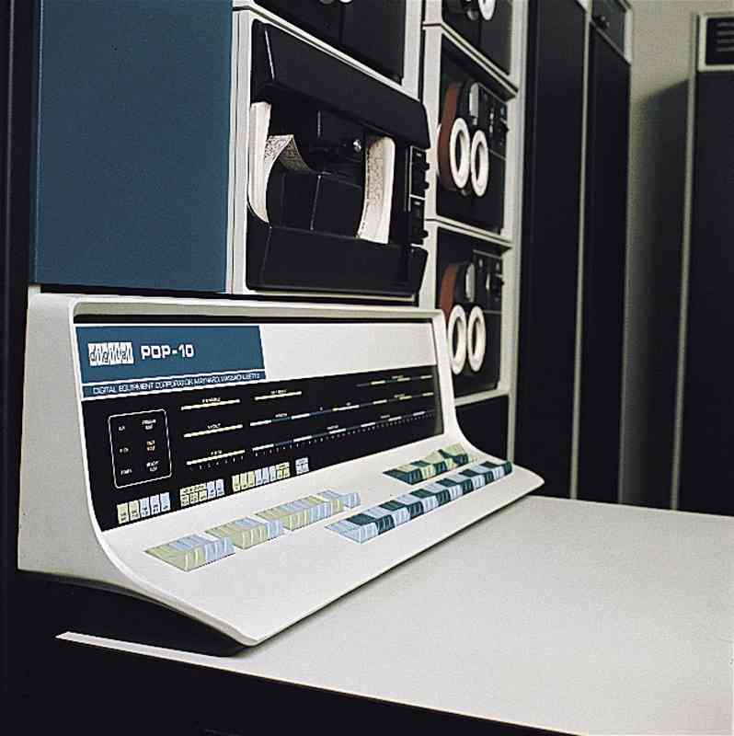
Machine language
Computer hardware is designed to do
A very limited set of operations
Very fast
Very cheaply
Basically simple operations on elements of a big array (memory)
m[a] = m[b] op m[c]
An instruction specifies a, b, c, and the operation
Instruction essentially encoded as obscure integers

Slide 5
Machine language
Good hardware design
Bad human interface

Slide 6
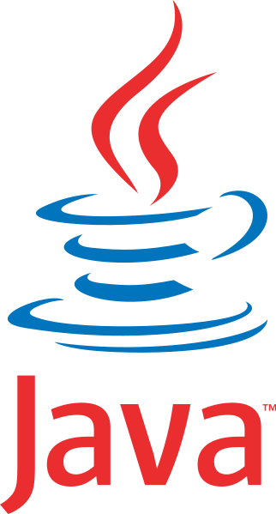

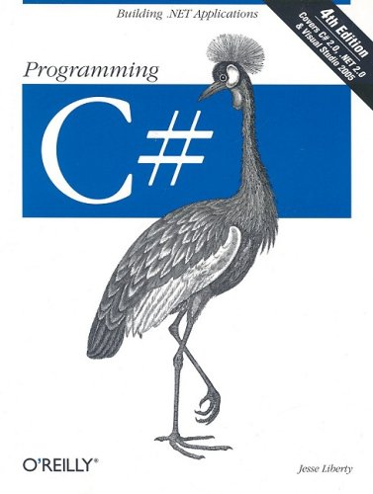
Higher-level languages
Let programmers work with higher-level entities
Objects
Fields
Using higher-level operations
Methods
Modules

Slide 7
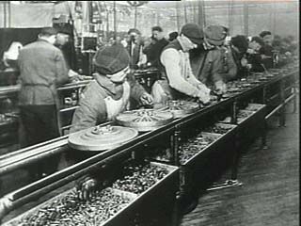
Division of labor
EEs and CEs build the fastest hardware they can to run machine language
Optimize hardware efficiency
CS people make the highest-level languages they can
Optimize human efficiency
Compilers and interpreters make higher-level languages run on machine-language platforms

Slide 8
Compilers and interpreters
Compiler
Takes a program in one language and
Translates it into another
Usually high to low
Interpreter
Takes a program in a language
And runs it directly
By stepping through it and performing the operations it specifies
target
language
compiler
source
language
interpreter
program output

Slide 9
Anatomy of a programming language
Programming languages are specified by grammars
A grammar specifies how
expressions (phrases)
are broken up into subexpressions (subphrases)
Sentence ⇒ NP VP
NP ⇒ [Art] [Adj] Noun
VP ⇒ Verb NP
Art = { the, a, an, some, … }
Adj = { green, happy, big, … }
Noun = { plate, president, cat, capitalism, … }
Verb = { be, eat, run, … }
A really lame grammar for English

Slide 10
Simplified grammar for Scheme
Expression ⇒ ComplexExpression | SimpleExpression
ComplexExpression ⇒ ‘(‘ Expressions … ‘)’
SimpleExpression ⇒ Number | String | Variable
(note: the | means “or”)

Slide 11
(Over) simplified grammar for C-like languages
Expression ⇒ Constant | Variable
| Expression Op Expression
| ‘(‘ Expression ‘)’
| Expression ‘.’ MemberName
| Expression ‘.’ MethodName ‘(‘ Expression, … ‘)’
Constant ⇒
Number | ‘true’ | ‘false” | ‘null’ | String
Op ⇒ ‘+’ | ‘-’ | ‘*’ | ‘=‘ | …

Slide 12
Syntax trees (aka parse trees) (You knew trees had to be coming here somewhere, right?)
Represent the internal structure of an expression
Its subexpressions
Tree structure (duh)
Nodes labeled with type of expression
Children are subexpressions
+
-
+
a
1
b
*
2
c
(a-1)+b+2*c

Slide 13
Parsing
Breaking expression into its constituent parts
Creates parse tree from linear string of tokens
Software for parsing is called a parser
+
-
+
a
1
b
*
2
c
(a-1)+b+2*c

Slide 14
Parsing
Algorithms for parsing
Extensively studied
Outside the scope of this class
Cool at a high level
Very boring in the details
In practice, one usually uses a parser generator,
Program that takes a grammar as input
Produces a parser as output
+
-
+
a
1
b
*
2
c
(a-1)+b+2*c

Slide 15
Parsing
That’s all we’re going to say about parsing …
+
-
+
a
1
b
*
2
c
(a-1)+b+2*c

Slide 16
Compositional semantics
An expression’s meaning is
Derived from
The meanings of its parts
In some systematic manner
+
1
*
2
3

Slide 17
Compositional semantics
Example
The value (meaning) of a sum expression
+
1
*
2
3

Slide 18
Compositional semantics
Example
The value (meaning) of a sum expression
Is the values of its subexpressions
+
1
6
1
*
2
3

Slide 19
Compositional semantics
Example
The value (meaning) of a sum expression
Is the values of its subexpressions
Added together
7
+
1
*
2
3

Slide 20
Syntax-directed interpretation
An interpreter works by following the structure of the syntax tree
Example
Arithmetic expressions: find the value of a parent node
By finding the values of subtrees
And using them as arguments to the function the parent node represents
+
1
*
2
3

Slide 21
Syntax-directed interpretation
Interpreter for arithmetic expressions
Run(STNode) {
leftValue = Run(STNode.leftChild)
rightValue = Run(STNode.rightChild)
return STNode.Operator(leftValue, rightValue)
}
+
1
*
2
3

Slide 22
Syntax-directed interpretation
Okay, in reality, we have to handle
the case where the node isn’t an operator
Run(STNode) {
if STNode is a constant
return the constant
else
leftValue = Run(STNode.leftChild)
rightValue = Run(STNode.rightChild)
return STNode.Operator(leftValue, rightValue)
}
+
1
*
2
3

Slide 23
Syntax-directed interpretation
Run(+)
+
1
*
2
3

Slide 24
Syntax-directed interpretation
Run(+)
Run(1)
+
1
*
2
3

Slide 25
Syntax-directed interpretation
Run(+)
Run(1)
return 1
+
1
1
*
2
3

Slide 26
Syntax-directed interpretation
Run(+)
Run(1)
return 1
Run(*)
+
1
*
2
3

Slide 27
Syntax-directed interpretation
Run(+)
Run(1)
return 1
Run(*) Run(2)
+
1
*
2
3

Slide 28
Syntax-directed interpretation
Run(+)
Run(1)
return 1
Run(*) Run(2) return 2
+
1
*
2
2
3

Slide 29
Syntax-directed interpretation
Run(+)
Run(1)
return 1
Run(*) Run(2) return 2 Run(3)
+
1
*
2
3

Slide 30
Syntax-directed interpretation
Run(+)
Run(1)
return 1
Run(*) Run(2) return 2 Run(3)
return 3
+
1
*
3
2
3

Slide 31
Syntax-directed interpretation
Run(+)
Run(1)
return 1
Run(*) Run(2) return 2 Run(3)
return 3
return 6
+
6
1
*
2
3

Slide 32
Syntax-directed interpretation
Run(+)
Run(1)
return 1
Run(*) Run(2) return 2 Run(3)
return 3
return 6
return 7
7
+
1
*
2
3

Slide 33
Syntax-directed interpretation
Look familiar?
Run(STNode) {
leftValue = Run(STNode.leftChild)
rightValue = Run(STNode.rightChild)
return STNode.Operator(leftValue, rightValue)
}
+
1
*
2
3

Slide 34
Post-order traversal
This is just a depth-first walk
In particular, a post-order walk
This is a super-simplified case
Only arithmetic expressions
Only binary trees
But the idea is much the same for more complicated cases
+
1
*
2
3

Slide 35
Syntax-directed interpretation
A more general version:
(not limited to 2-argument operators)
Run(STNode) {
arguments =
new object[STNode.Children.Length]
for (i=0; i<results.Length; i++)
arguments[i] = Run[STNode.Children[i]
return STNode.Operator(arguments)
}
+
1
*
2
3

Slide 36
Handling variable references
That’s great!
But what do we do when we see a variable?
+
-
+
a
1
b
*
2
c

Slide 37
Environments
Name | Value
a | 5
b | -2
c | 4.2
+
-
+
a
1
b
*
Data structures that store the values of variables
2
c

Slide 38
Dictionaries
A.k.a. associative array, map, mapping
Data structure that holds associations between pairs of objects called keys and values
Simplified interface (we’ll talk more about dictionaries later):
dict.Store(key, value)
Adds key to dictionary with associated value
We’ll assume that if the key is already present, this changes its value
dict.Lookup(key)
Returns value associated with key in dict

Slide 39
Implementing dictionaries with association lists
The simplest possible implementation of dictionaries is as a linked list of key/value pairs
Each cell has three fields
Key
Value
Link to next cell
a
5
b
-2
c
4.2

Slide 40
Implementing dictionaries with association lists
This isn’t a great representation because lookup requires linear time
i.e. O(n)
Next week, we’ll look at structures that can do lookup in log time
And after that, (near) constant time
a
5
b
-2
c
4.2

Slide 41
Handling variable references
Now all we have to do is
Add a rule for handling nodes that are variable references
Add a dictionary argument to the Run procedure that holds the current environment
+
-
+
a
1
b
*
2
c

Slide 42
Handling variable references
+
Run(STNode, dict) {
if STNode is a constant
return the constant
else if STNode is a variable
return dict.Lookup(STNode.variableName)
else
leftValue = Run(STNode.leftChild, dict)
rightValue = Run(STNode.rightChild, dict)
return STNode.Operator(leftValue, rightValue)
}
-
+
a
1
b
*
2
c

Slide 43
Bleh! This is ugly!
+
Run(STNode, dict) {
if STNode is a constant
return the constant
else if STNode is a variable
return dict.Lookup(STNode.variableName)
else
leftValue = Run(STNode.leftChild, dict)
rightValue = Run(STNode.rightChild, dict)
return STNode.Operator(leftValue, rightValue)
}
-
+
a
1
b
*
2
c

Slide 44
Inheritance to the rescue!
abstract class Expression { … other stuff …
abstract object Run(Dictionary d);
}
class Constant : Expression {
… other stuff …
overrideRun(Dictionary d) {
return the value of the constant
} }
class VariableReference : Expression {
… other stuff …
overrideRun(Dictionary d) {
return look up variable name in d
} }
+
-
+
a
1
b
*
2
c
class OperatorExpression : Expression {
… other stuff …
override Run(Dictionary d) {
Call run on all the children to get their values
Apply the operator to the list of values return the result of the operator
}

Slide 45
Compilation
Compilers are just like interpreters
Depth-first traversal of the syntax tree
Incrementally builds up the output by finding the output for subtrees
At least to a first approximation…

Slide 46
Compilation
The difference is that
When an interpreter sees +, it outputs the sum
When a compilers sees +, it outputs machine code to compute the sum

Slide 47
Stack machines (you knew we had to get stacks in here too…)
Simple kind of machine code
No longer popular for hardware implementation
But still popular as an intermediate code for “bytecoded” languages like Java, C#, Python
Stores intermediate results on a stack
Basic operations
Push: pushes a constant on the stack
Arithmetic (e.g. +)
Pops arguments from stack
Computes result
Pushes result on stack
Other stuff
Load/store for variables
Procedure call
Other good stuff
But we don’t have time to talk about these

Slide 48
Computing 1+2*3 on a stack machine
Program:
Push 1
Push 2
Push 3
*
+
Stack

Slide 49
Computing 1+2*3 on a stack machine
Program:
Push 1
Push 2
Push 3
*
+
1
Stack

Slide 50
Computing 1+2*3 on a stack machine
Program:
Push 1
Push 2
Push 3
*
+
2
1
Stack

Slide 51
Computing 1+2*3 on a stack machine
Program:
Push 1
Push 2
Push 3
*
+
3
2
1
Stack

Slide 52
Computing 1+2*3 on a stack machine
Program:
Push 1
Push 2
Push 3
*
+
6
1
Stack

Slide 53
Computing 1+2*3 on a stack machine
Program:
Push 1
Push 2
Push 3
*
+
7
Stack

Slide 54
Syntax-directed compilation
Just change the code for run so that
Instead of performing an operation
It outputs code that can perform it
Compile(STNode) {
if STNode is a constant
add “push constant” to the code
else
Compile(STNode.leftChild)
Compile(STNode.rightChild)
add STNode.Operator to the compiled code
}
+
1
*
2
3

Slide 55
Syntax-directed compilation
Generated code:
Compile(+)
+
1
*
2
3

Slide 56
Syntax-directed compilation
Generated code:
Compile(+)
Compile(1)
+
1
*
2
3

Slide 57
Syntax-directed compilation
Generated code:
Push 1
Compile(+)
Compile(1)
Emit “push 1”
+
1
*
2
3

Slide 58
Syntax-directed compilation
Generated code:
Push 1
Compile(+)
Compile(1)
Emit “push 1”
Compile(*)
+
1
*
2
3

Slide 59
Syntax-directed compilation
Generated code:
Push 1
Compile(+)
Compile(1)
Emit “push 1”
Compile(*)
Compile(2)
+
1
*
2
3

Slide 60
Syntax-directed compilation
Generated code:
Push 1 push 2
Compile(+)
Compile(1)
Emit “push 1”
Compile(*)
Compile(2)
Emit “push 2”
+
1
*
2
3

Slide 61
Syntax-directed compilation
Generated code:
Push 1 push 2
Compile(+)
Compile(1)
Emit “push 1”
Compile(*)
Compile(2)
Emit “push 2”
Compile(3)
+
1
*
2
3

Slide 62
Syntax-directed compilation
Generated code:
Push 1 push 2 push 3
Compile(+)
Compile(1)
Emit “push 1”
Compile(*)
Compile(2)
Emit “push 2”
Compile(3)
Emit “push 3”
+
1
*
2
3

Slide 63
Syntax-directed compilation
Generated code:
Push 1 push 2 push 3 *
Compile(+)
Compile(1)
Emit “push 1”
Compile(*)
Compile(2)
Emit “push 2”
Compile(3)
Emit “push 3”
Emit *
+
1
*
2
3

Slide 64
Syntax-directed compilation
Generated code:
Push 1 push 2 push 3 * +
Compile(+)
Compile(1)
Emit “push 1”
Compile(*)
Compile(2)
Emit “push 2”
Compile(3)
Emit “push 3”
Emit *
Emit +
+
1
*
2
3

Slide 65
trees rock!

Slide 66
Assignment 2
Out Friday
Due next Friday
Make a simple interpreter
More like a fancy calculator
Create ListDictionary class for representing environments
Fill in Run methods for Expression classes
Testing
Write your own unit tests
Try it out by running it in a GUI

Slide 67
The Interpreter class
A static class
Contains the Environment property
Called, not surprisingly, Interpreter.Environment
Of type ListDictionary
Oh, yea. You’ll be implementing that too
Also contains static methods for helping you write an interpreter

Slide 68
Wait, what’s a static class?
A class you can’t make any instances of
It’s just a place to stick methods (procedures) that you’d like to be able to call
It can also have static fields and properties

Slide 69
How do you call the class’s methods if you can’t make an instance it?

Slide 70
How do you call the class’s methods if you can’t make an instance it?
They’re static methods, of course

Slide 71
Okay, what’s a static method?

Slide 72
Okay, what’s a static method?
A method you don’t need an object for

Slide 73
Okay, what’s a static method?
It’s just part of the class

Slide 74
The Expression class
Abstract class for parse tree nodes (aka syntax tree nodes)
Interesting members are:
Subexpressions
Array of child nodes
ToString()
Converts it to a string in Scheme format
Run(dictionary)
You, um, fill this part in
+
1
*
2
3

Slide 75
The Expression subclasses
Constant
A tree node representing a constant (1, false, “fred”, etc.)
VariableReference
Gives the current value of a variable
VariableAssignment
Changes value of said variable
MemberReference, MemberAssignment
Same, but for fields or properties of an object
MethodCall
Calls a method of an object
+
1
*
2
3

Slide 76
The Expression subclasses
Constant
A tree node representing a constant (1, false, “fred”, etc.)
VariableReference
Gives the current value of a variable
VariableAssignment
Changes value of said variable
MemberReference, MemberAssignment
Same, but for fields or properties of an object
MethodCall
Calls a method of an object
OperatorExpression
Represents a +, -, *, or / expression
+
1
*
2
3
You get to fill in the run methods of these subclasses

Slide 77
The Expression subclasses
Run(dictionary) returns
For a Constant
Whatever the constant is
For a VariableReference
Looks up variable by name in dictionary and returns its value
For a VariableAssignment
Updates value of variable in dictionary
And returns value
+
1
*
2
3

Slide 78
Getting the value of a field
class MemberReference : Expression
{
public Expression ObjectExpression { get; private set; }
public string MemberName { get; private set; }
public override object Run(ListDictionary dict)
{
// Get the object for which we want the field
object obj = ObjectExpression.Run(dict); return obj.MemberName
}
}

Slide 79
What’s wrong with this code?
class MemberReference : Expression
{
public Expression ObjectExpression { get; private set; }
public string MemberName { get; private set; }
public override object Run(ListDictionary dict)
{
// Get the object for which we want the field
object obj = ObjectExpression.Run(dict); return obj.MemberName
}
}

Slide 80
What’s wrong with this code?
class MemberReference : Expression
{
public Expression ObjectExpression { get; private set; }
public string MemberName { get; private set; }
public override object Run(ListDictionary dict)
{
// Get the object for which we want the field
object obj = ObjectExpression.Run(dict); return obj.MemberName
}
}
This asks for the field of obj whose name is “MemberName”

Slide 81
What’s wrong with this code?
class MemberReference : Expression
{
public Expression ObjectExpression { get; private set; }
public string MemberName { get; private set; }
public override object Run(ListDictionary dict)
{
// Get the object for which we want the field
object obj = ObjectExpression.Run(dict); return obj.MemberName
}
}
Not the field whose name itself is stored in MemberName

Slide 82
How do we ask for a member whose name we don’t know until run time?
class MemberReference : Expression
{
public Expression ObjectExpression { get; private set; }
public string MemberName { get; private set; }
public override object Run(ListDictionary dict)
{
// Get the object for which we want the field
object obj = ObjectExpression.Run(dict); return obj.MemberName
}
}

Slide 83

Reflection
Modern languages store metadata about objects and their types
Object type
Its methods, fields, properties, etc.
This can be used at run-time to ask the system about an object
This is how Meta’s inspector was written
http://www.flickr.com/photos/froodmat/16722536/

Slide 84
The Type class
System has one Type object per data type in the system
Classes
Structs
Arrays
Etc.
The GetType() method of an object returns its type object
Essentially every object stores its type in a hidden field
GetType() reads the field
Type object stores information about the type’s
Name
Constructors
Fields
Methods
Properties
Events
Provides methods for manipulating objects of its type
Calling methods
Reading/writing fields
Etc.

Slide 85
Accessing members by name
The details of the .NET reflection system are outside the scope of this class
We’ve added wrapper methods to the Object class to make it easy to access fields by name
These can be called on any object whatsoever
Because all types are subclasses of Object
obj.GetMemberValue(name)
Returns the value of the member of obj whose name is given by the string memberName
obj.SetMemberValue(name, newValue)
Same, but modifies its value to be newValue
obj.CallMethod(name, args)
Like apply from Scheme
Calls method of obj given by name
Passes it the values in the array args as arguments

Slide 86
How do we ask for a member whose name we don’t know until run time?
class MemberReference : Expression
{
public Expression ObjectExpression { get; private set; }
public string MemberName { get; private set; }
public override object Run(ListDictionary dict)
{
// Get the object for which we want the field
object obj = ObjectExpression.Run(dict); return obj.GetMemberValue(MemberName);
}
}

Slide 87
Parsing
We’ve taken care of parsing for you
You need only worry about it
Expressions will already be built for your from code in the level files
But if you want to know how it works,
Look at the Parse static of the Expression class
Or see http://en.wikipedia.org/wiki/Operator-precedence_parser
+
1
*
2
3

Slide 88
Generic Arithmetic
object Interpreter.GenericOperator(string name, object[] arguments)
One problem with writing an interpreter is implementing arithmetic operators like +, -, *, and /
These operators need to do different things depending on the types of their arguments
ints
floats
doubles
vectors
whatever
We’ve provided a method to the interpreter class to take care of this for you
Interpreter.GenericOperator method
Inputs
Name of operator (string)
“+”, “-”, “*”, or “/”
Arguments to the operator
Array of type object[ ] with 1 or 2 values in it
Can include ints, floats, doubles, Vector3, or Matrix
Result
The value of adding, subtracting, or doing whatever else is specified to the arguments

Slide 89
any questions?

